Slide 1



AI Workshop 2: Building an ML Pipeline Saturday 22nd February 2025
Omar Choudhry

Slide 2

Learning Objectives
By the end of this lesson, you will learn:
What is data and its different types?
What is data pre-processing and how can we perform it?
What are the different types of machine learning (ML) models?
How can we use prompt engineering to help us write code?
What is an ML pipeline, and how can we use it to build AI?

Slide 3
Recap of Machine Learning
Machine learning: algorithms which learn patterns in data to make predictions

Slide 4



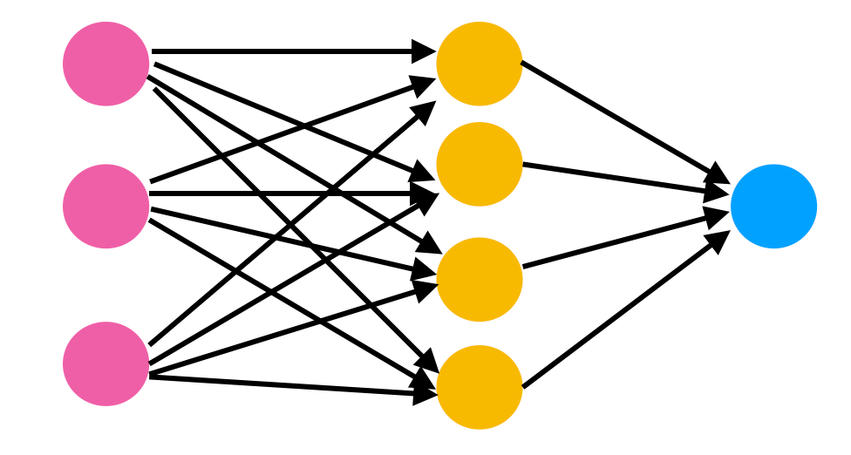
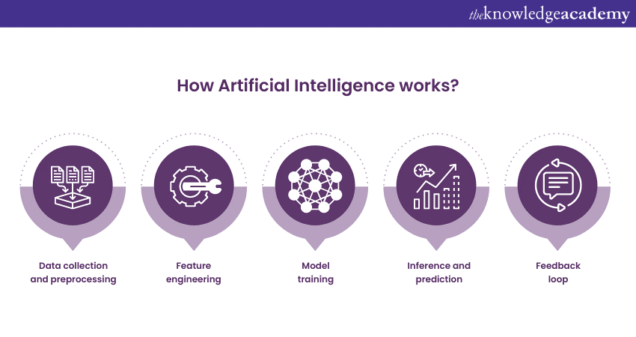
Recap of Machine Learning

Slide 5

Most Important Principle of ML

Slide 6





Types of Data

Slide 7
Types of Data
x | 1 | 2 | 3 | 4
y | 2 | 4 | 6 | 8
5
?
10
y
y = 2x
x
5

Slide 8

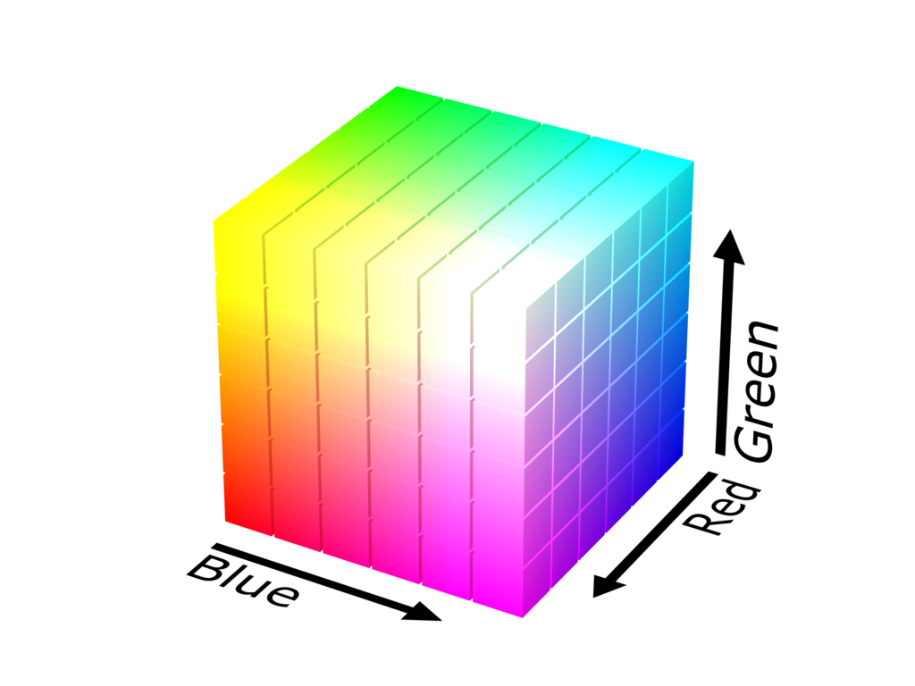

Types of Data
…
#AEC088
(174, 192, 136)
…
…
…
…
…
…

Slide 9

Types of Data

Slide 10

Types of Data

Slide 11

Types of Data

Slide 12
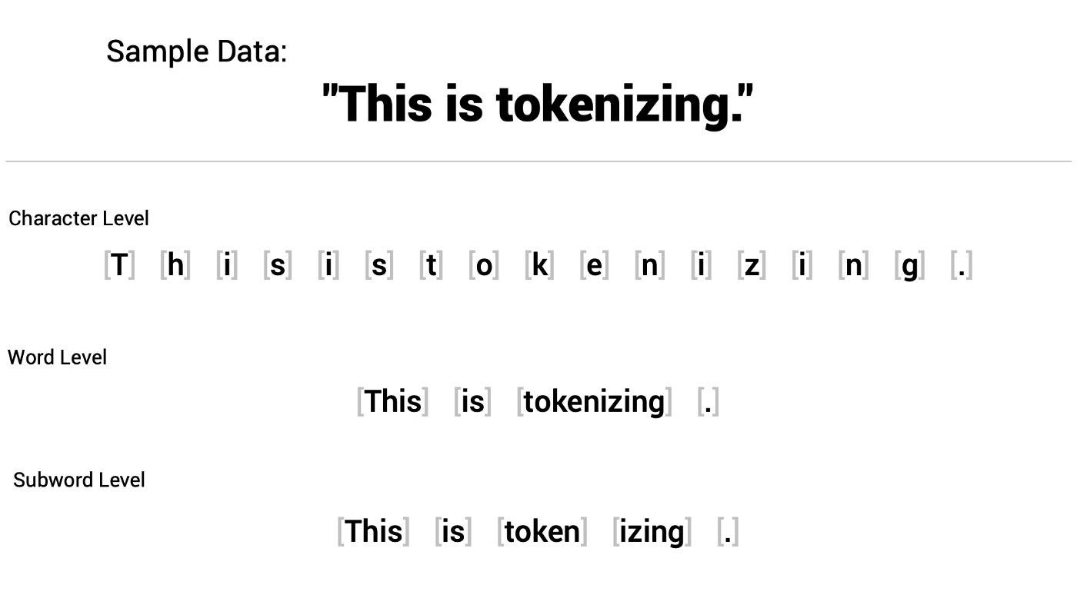
Types of Data

Slide 13
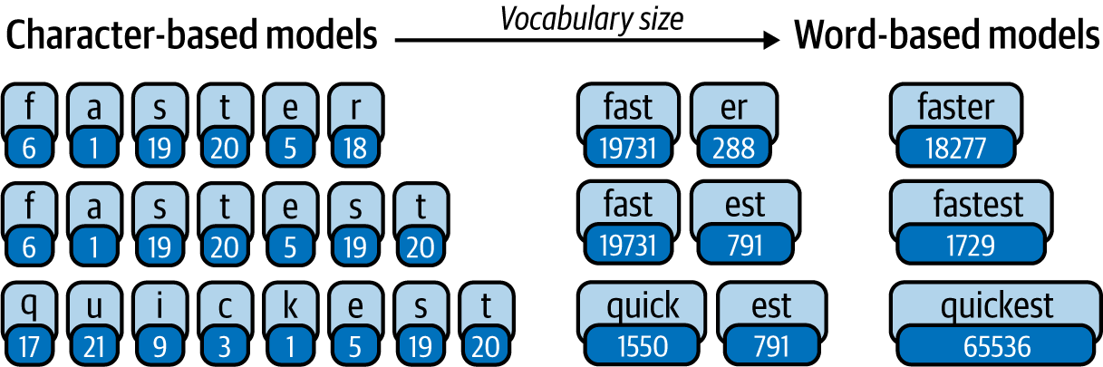
Types of Data

Slide 14
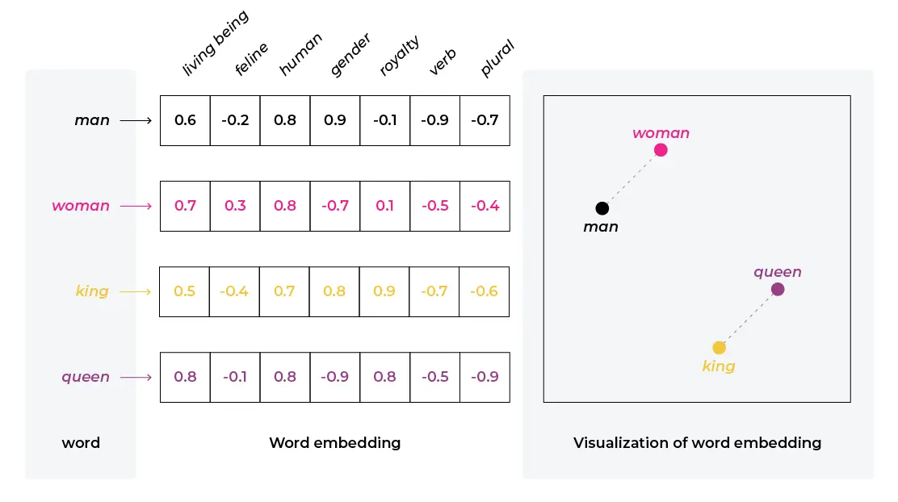
Types of Data

Slide 15
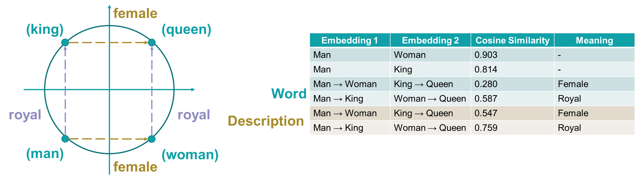
Types of Data

Slide 16
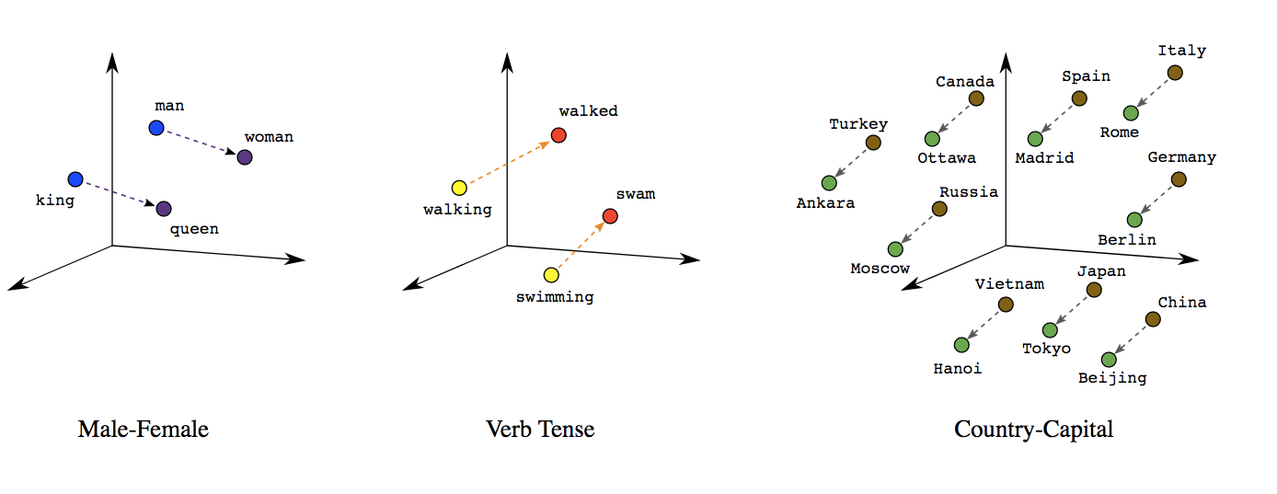
Types of Data

Slide 17

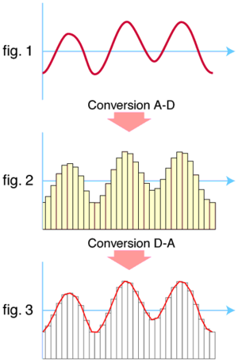
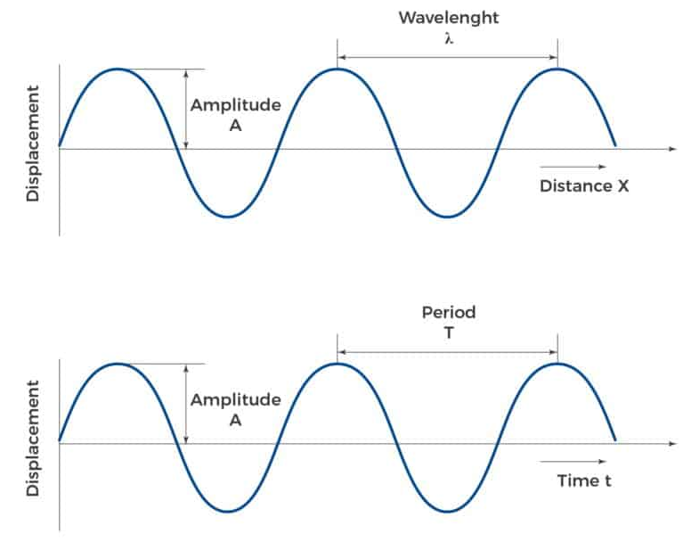
Types of Data

Slide 18
Data Preprocessing
Fixing problems with our data to make it more suitable for our algorithms

Slide 19
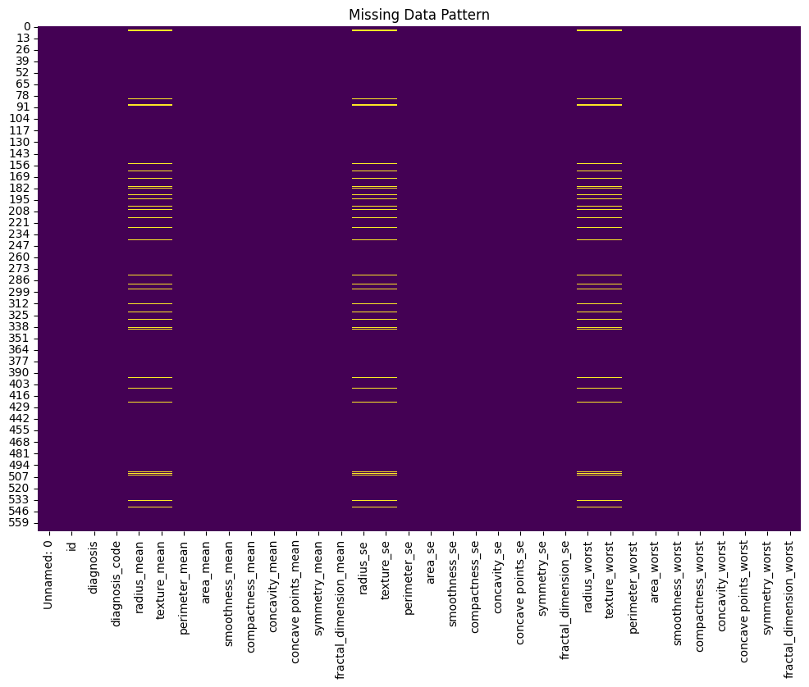
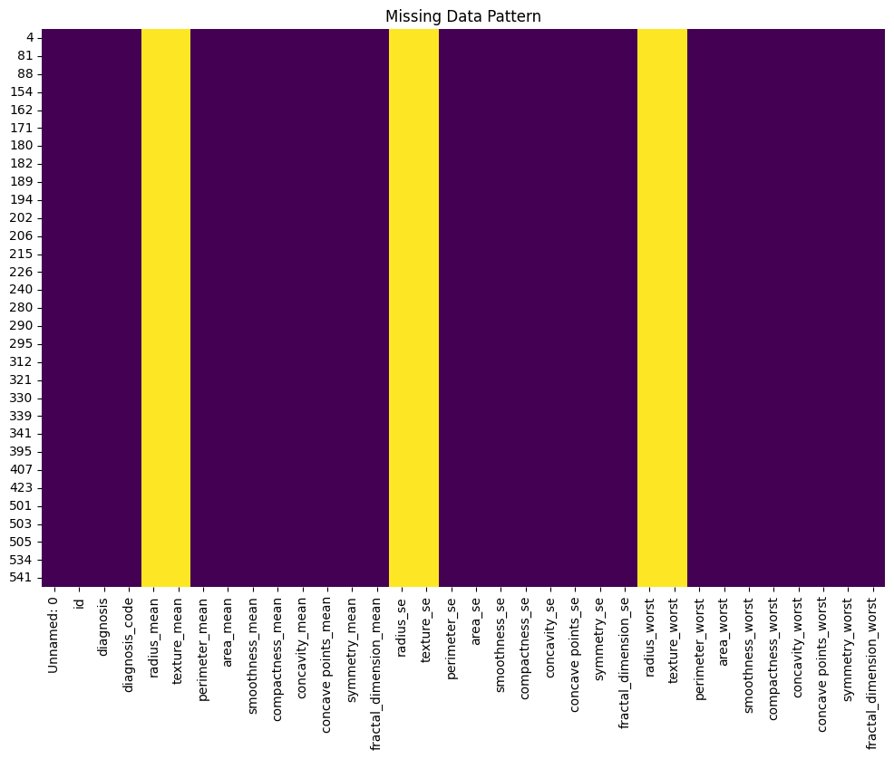
Missing Data
Understand the reason why you have missing data
Remove values or impute them

Slide 20
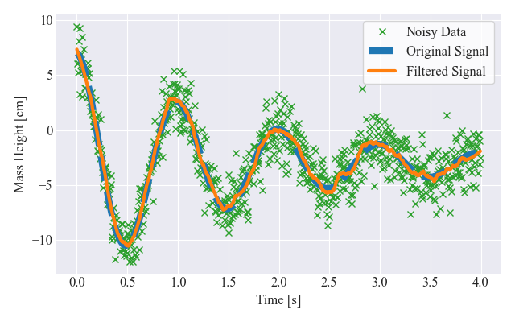
Noisy Data
Smooth out the data to reduce noise

Slide 21
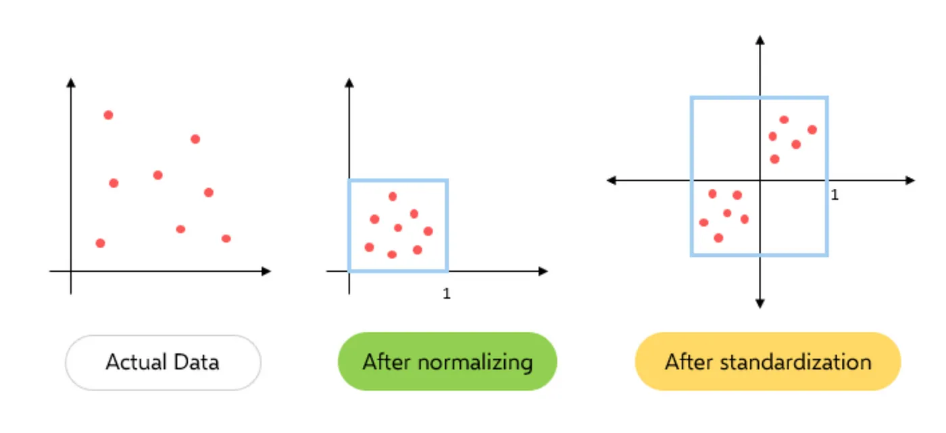
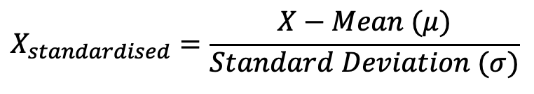
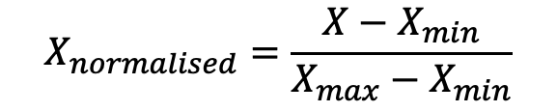
Extreme Values
Normalisation (transform data to a similar scale – between 0 and 1)
Standardisation (rescaling so the mean is 0 and variance is 1)
$$X_{normalised}=\frac{X−X_{min}}{X_{max}−X_{min}}$$
$$X_{standardised}=\frac{X−Mean (μ)}{Standard Deviation (σ)}$$

Slide 22
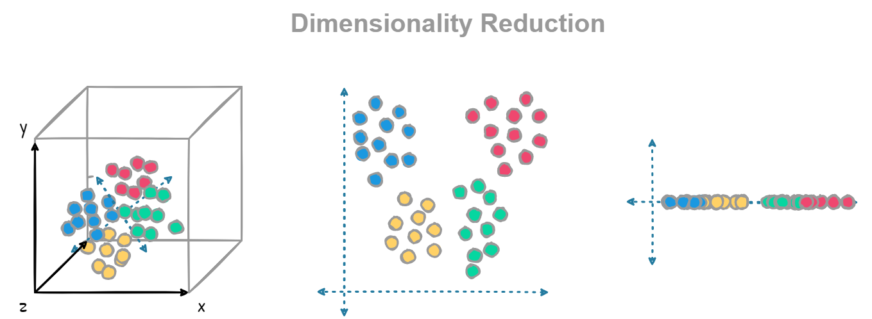
Too Large
Dimensionality reduction
10x10x10
1000 positions
10x10
100 positions
10
10 positions

Slide 23
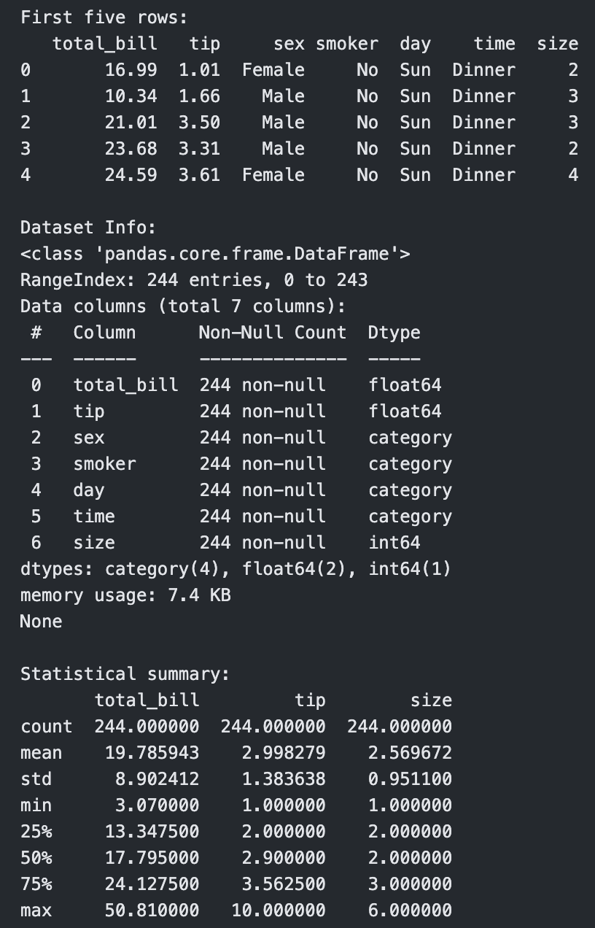
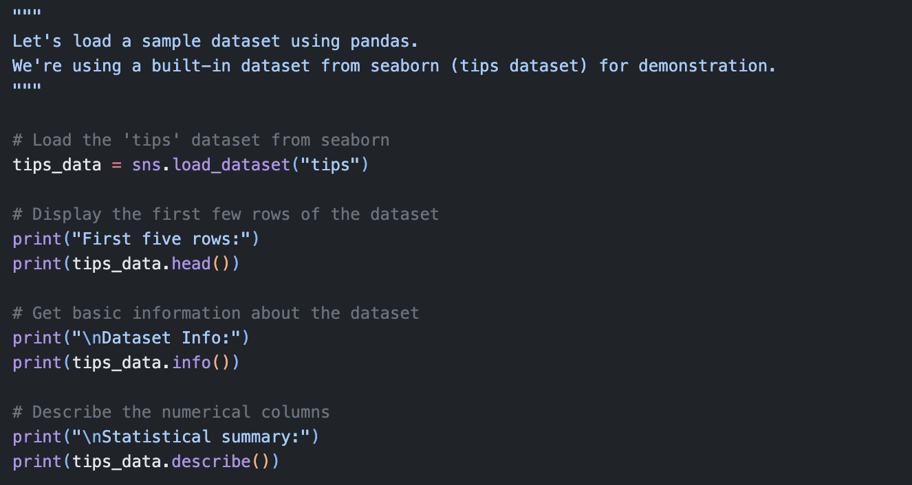
Categorical Data

Slide 24
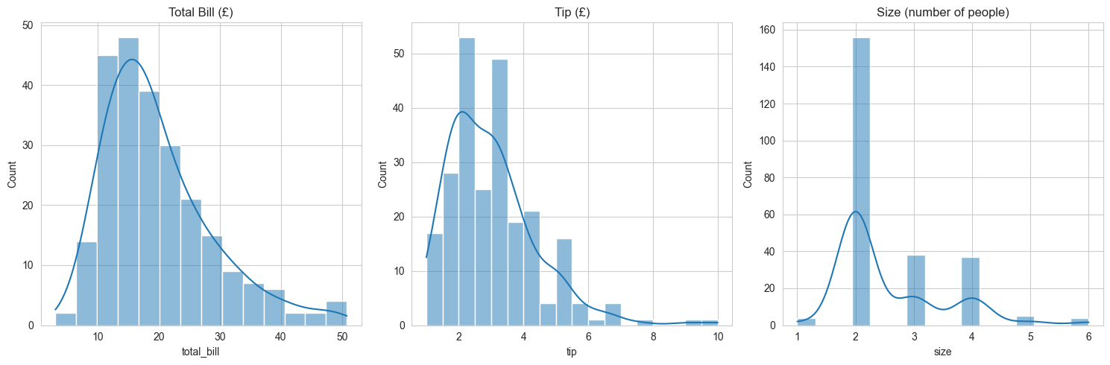
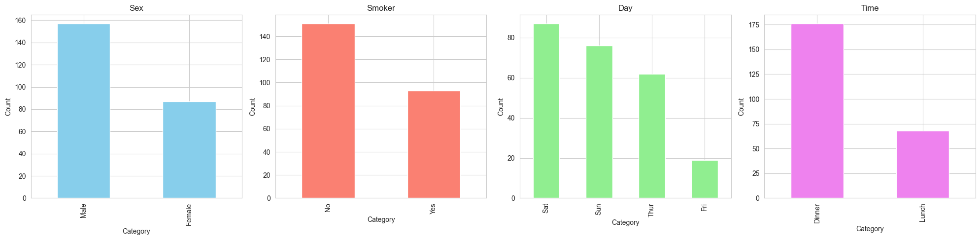
Categorical Data

Slide 25
Types of ML Models
Supervised Learning
Unsupervised Learning
Reinforcement Learning

Slide 26
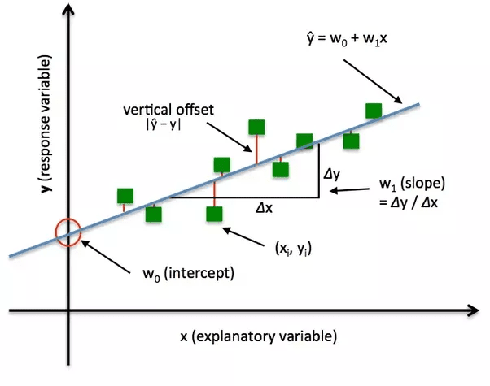
Types of ML Models

Slide 27
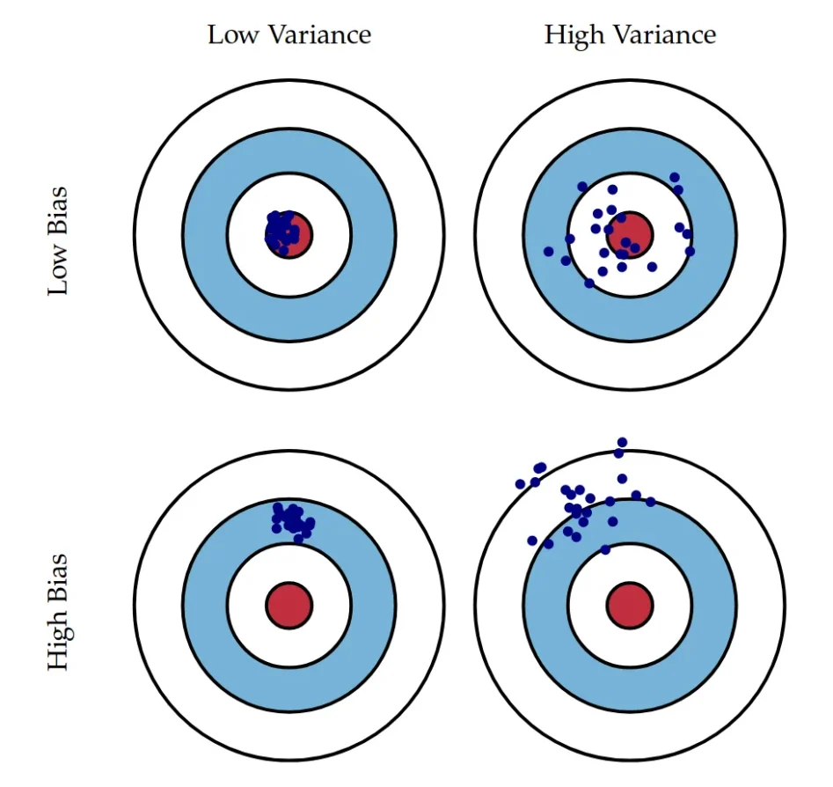
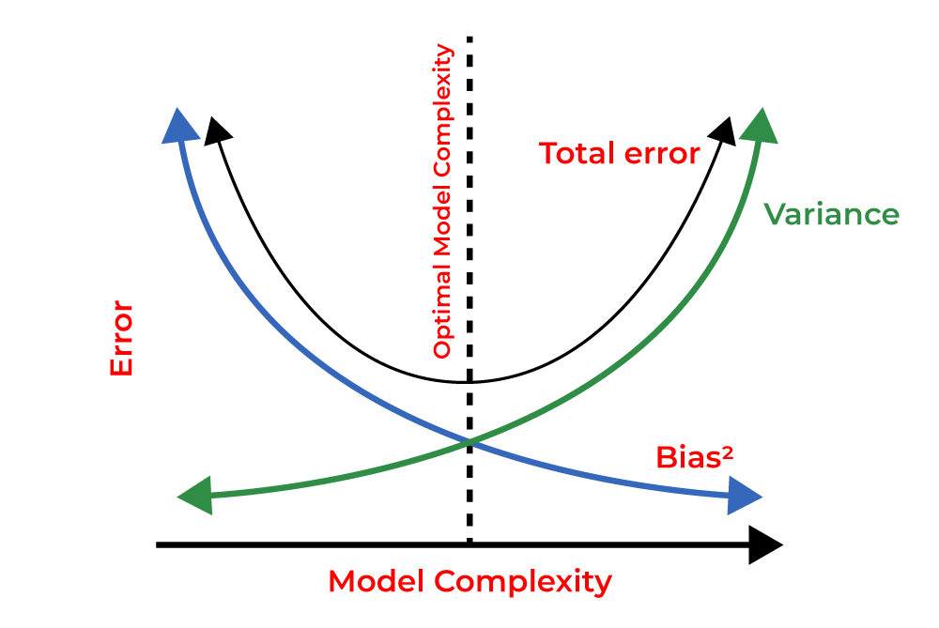
Types of ML Models

Slide 28
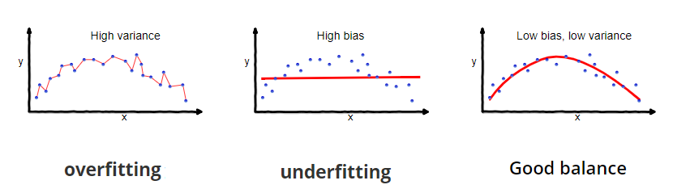
Types of ML Models

Slide 29
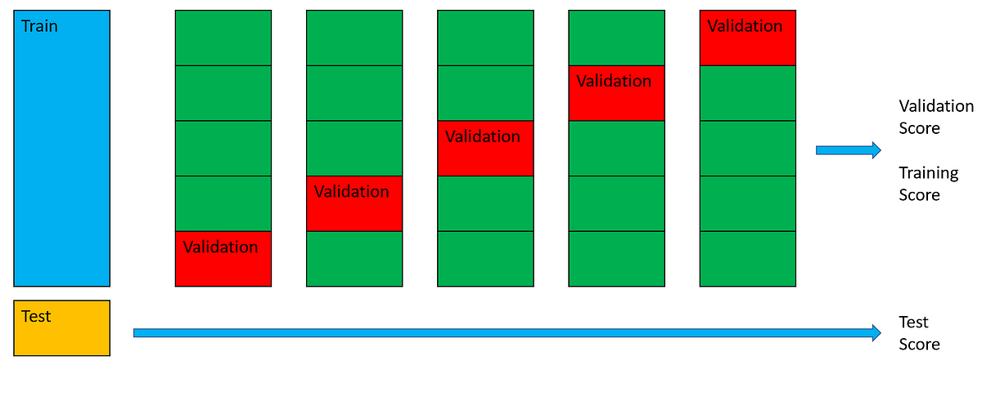
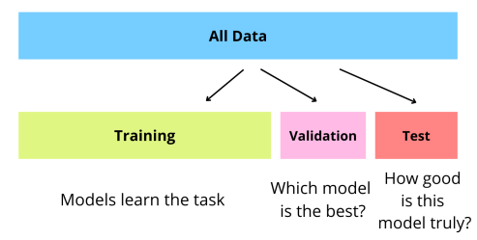
Types of ML Models

Slide 30

Supervised Learning

Slide 31
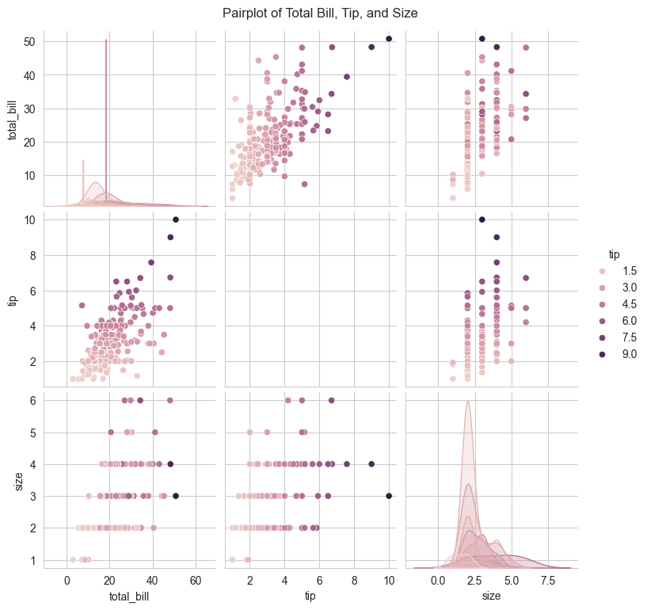
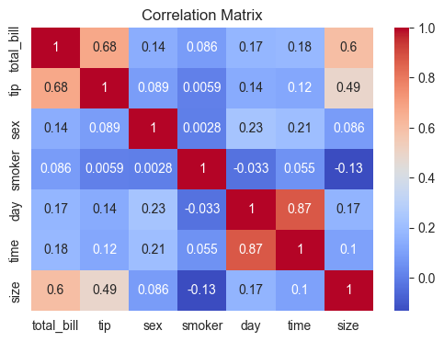
Supervised Learning

Slide 32
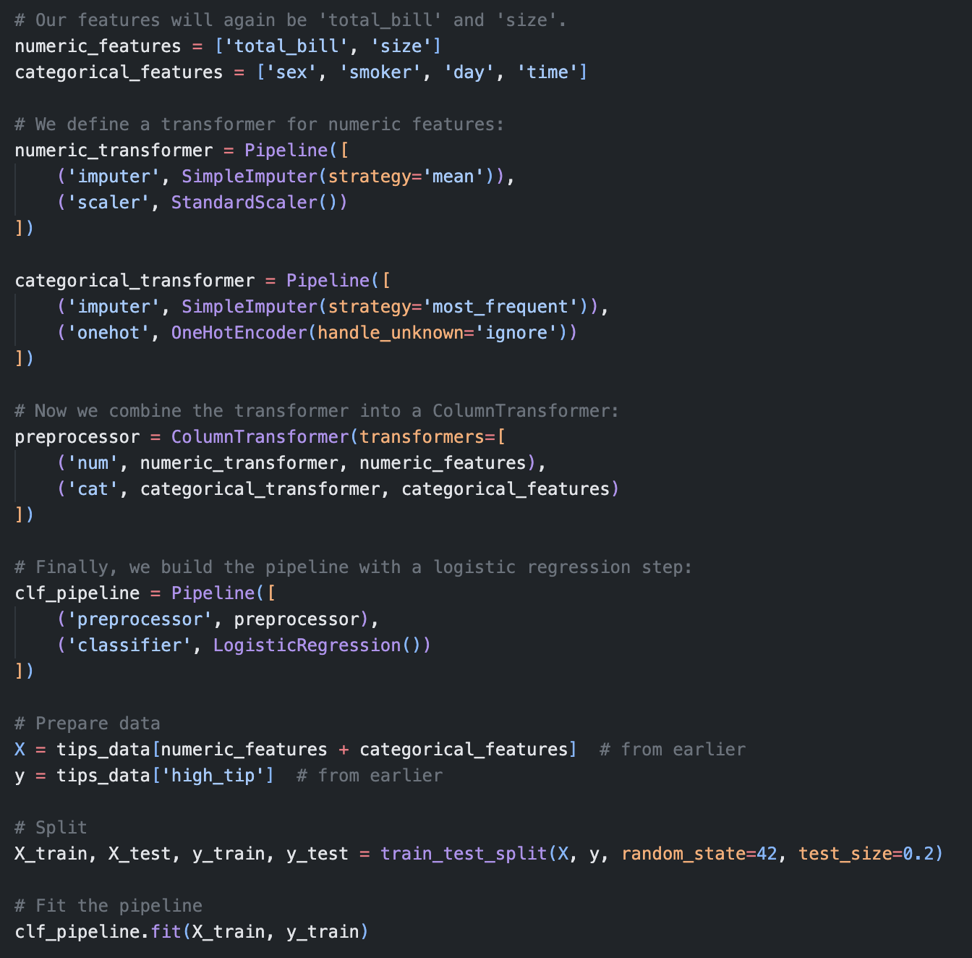
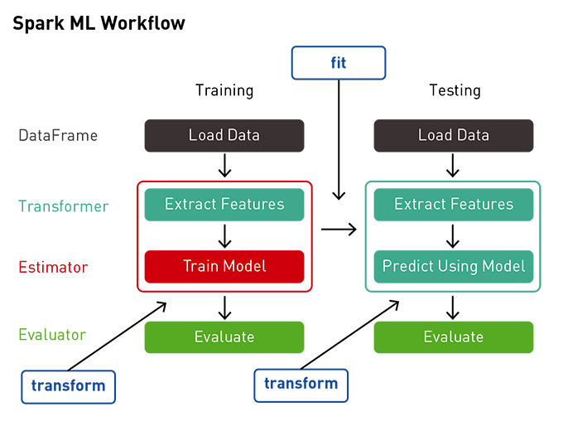
Supervised Learning

Slide 33
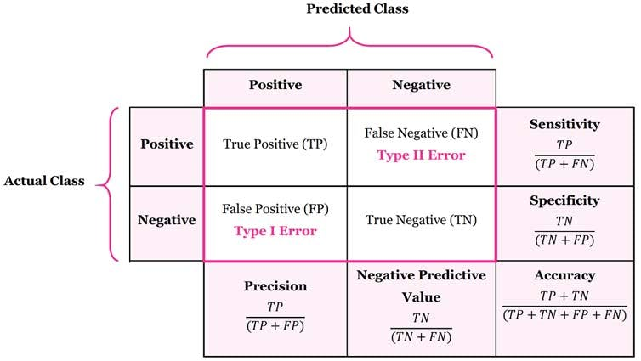
Supervised Learning

Slide 34
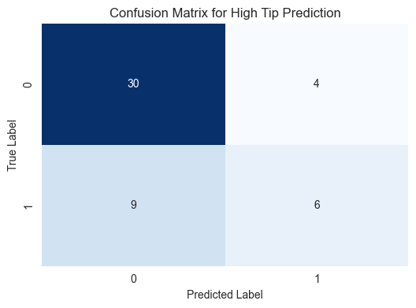
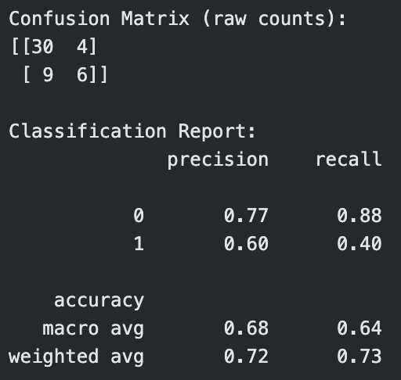
Supervised Learning

Slide 35
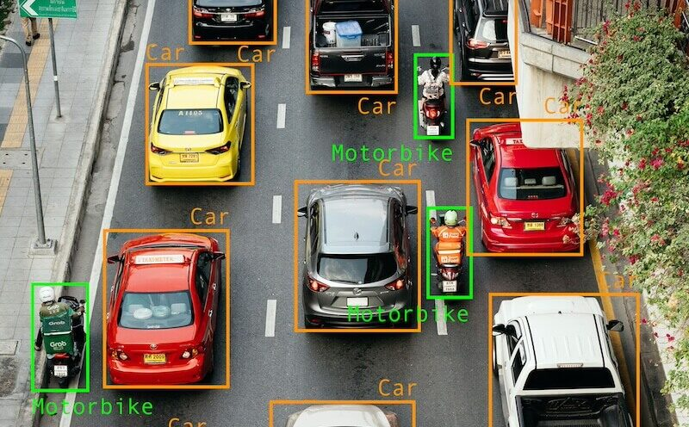
Supervised Learning

Slide 36
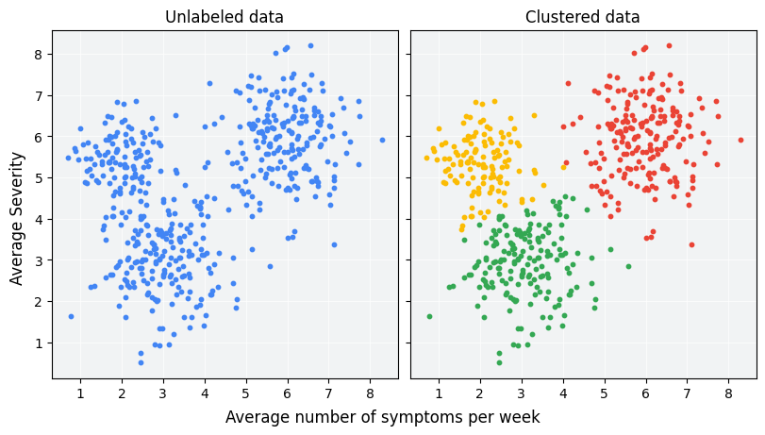
Unsupervised Learning

Slide 37
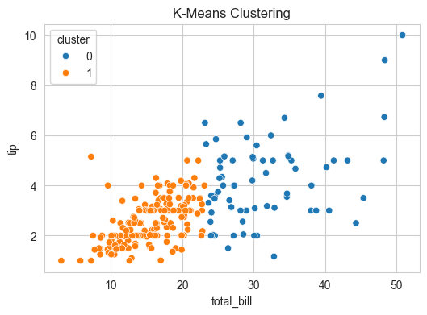
Unsupervised Learning

Slide 38


Reinforcement Learning

Slide 39
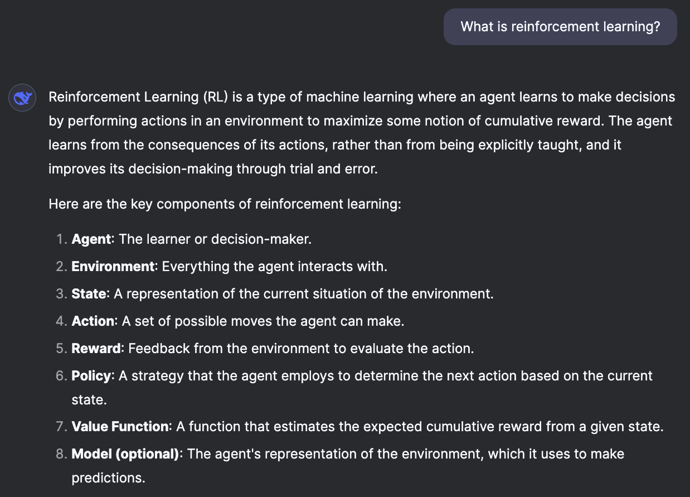
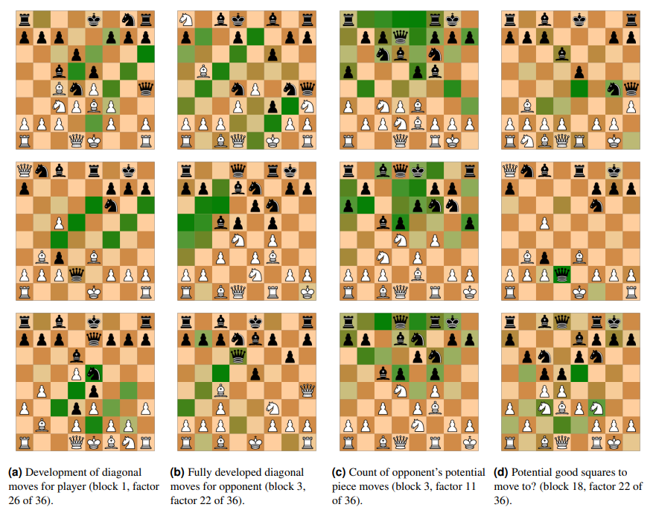
Reinforcement Learning

Slide 40
Prompt Engineering
Learning how to code can take time…
Pick a suitable Large Language Model (LLM) (e.g. Gemini is integrated in Google Colab)
Give detailed step-by-step instructions (e.g. Explain to me like I’m a 5 year old… Use comments throughout to explain your thought-process… Be specific etc.)
Try to understand the purpose of each line of code, even if you don’t understand the syntax
NOT A REPLACEMENT FOR NOT LEARNING HOW TO CODE

Slide 41
Let’s Build an ML Pipeline
Make sure you understand what problem you are trying to solve
Make your data as good as possible
Confirm what kind of predictions you are trying to make
Choose a suitable model to help you make those predictions
Test on more data and update model

Slide 42
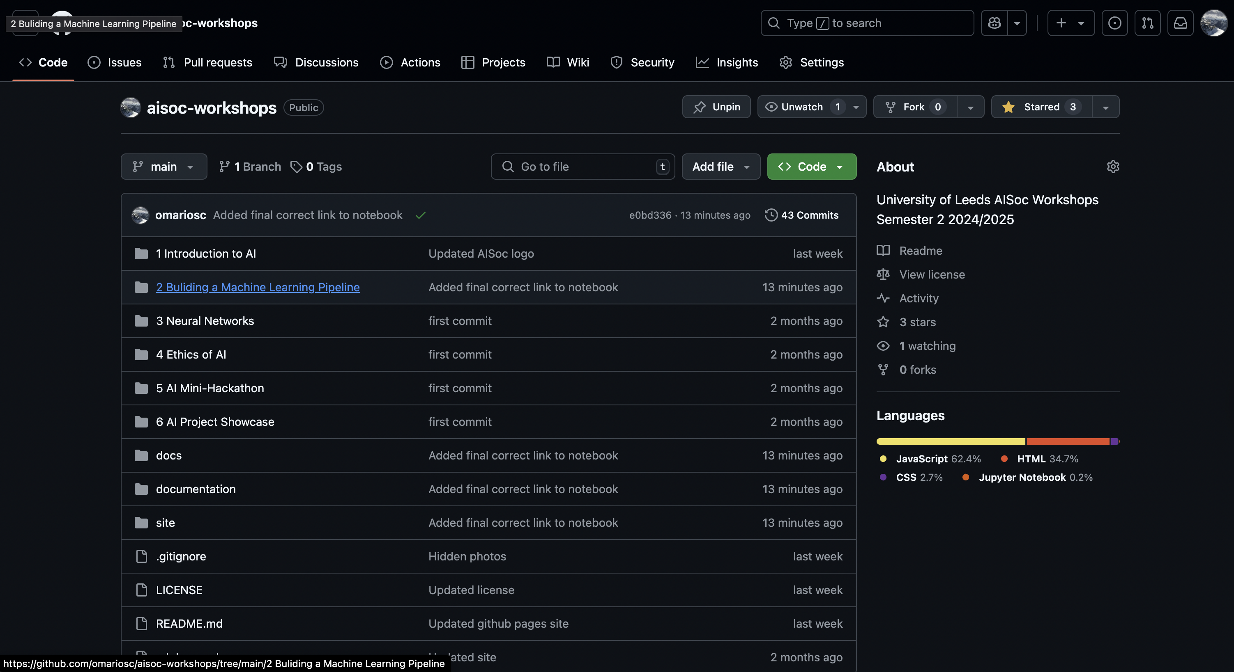
Let’s Build an ML Pipeline

Slide 43
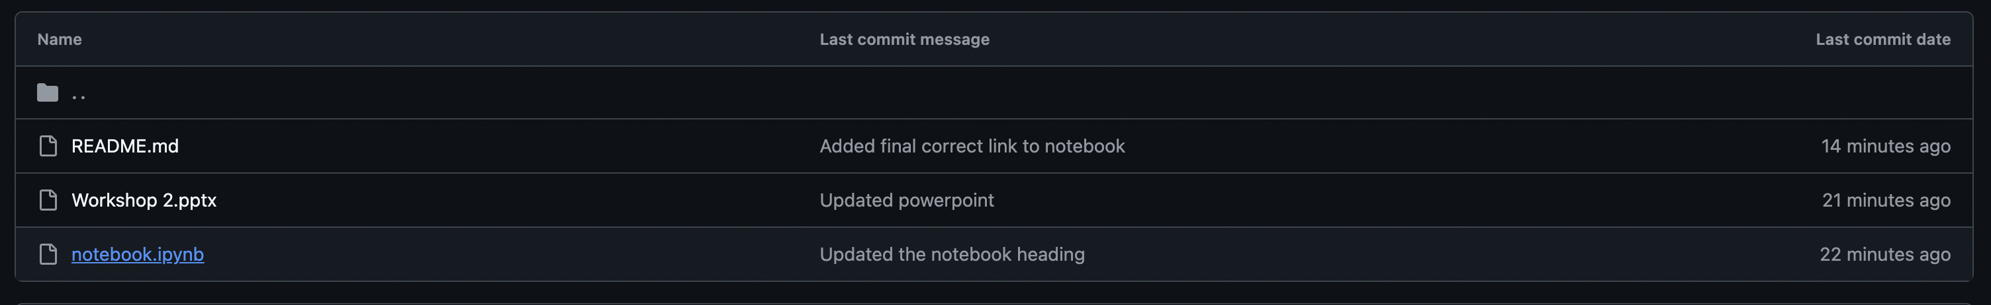
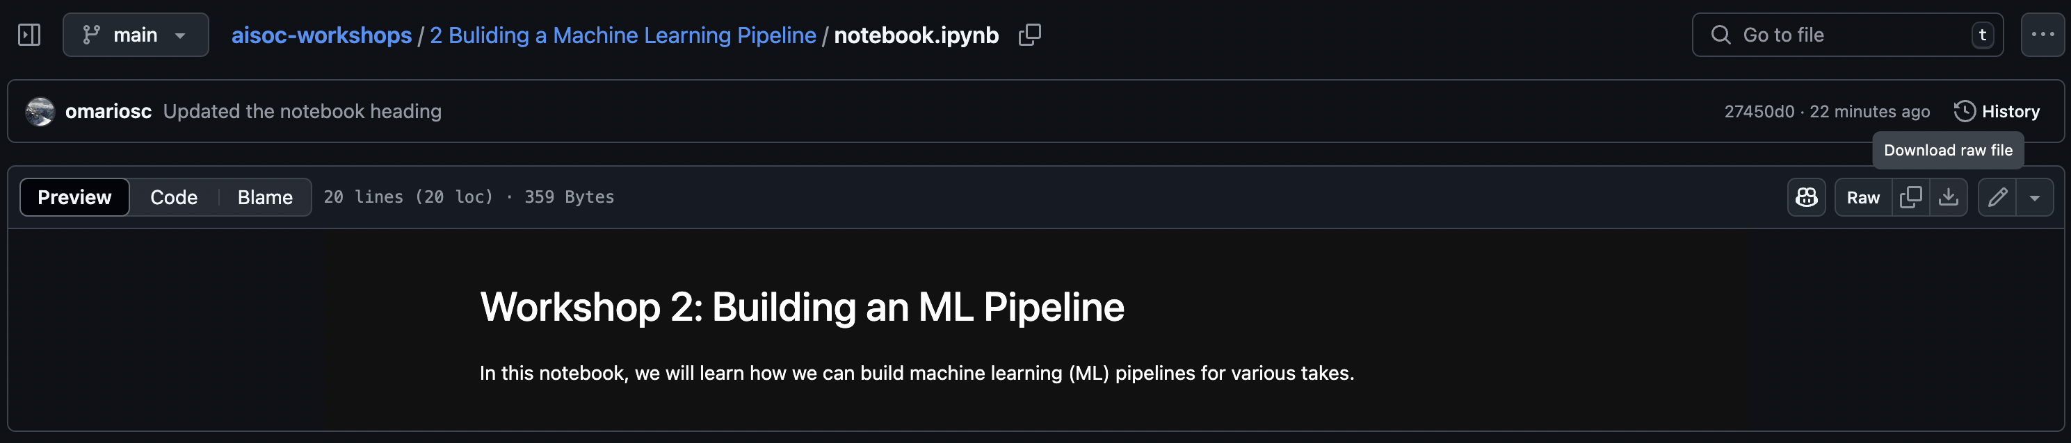
Let’s Build an ML Pipeline

Slide 44
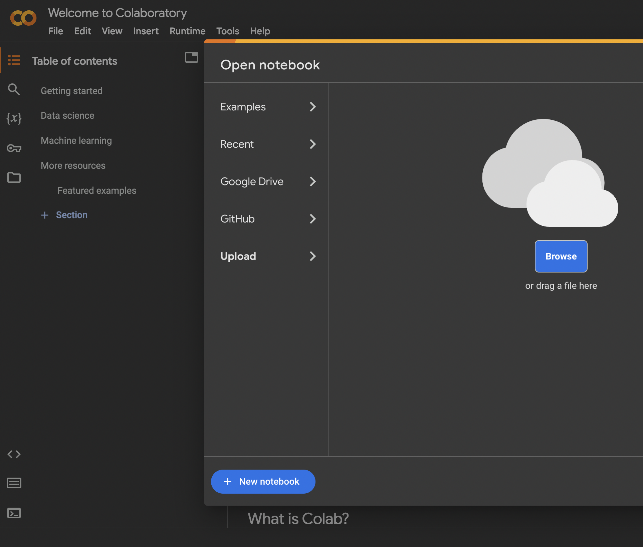
Let’s Build an ML Pipeline
Repository: https://github.com/omariosc/aisoc-workshops
Google Colab: https://colab.research.google.com/
Upload the notebook.ipynb file from the Workshop 2 folder

Slide 45



Feedback
Contact
Slides are available at github.com/omariosc/ai-workshops
O.Choudhry@leeds.ac.uk
Feedback Form
WhatsApp Community Chat

